Slide 1
Artificial Intelligence and Robotics

Slide 2
Departmental Vision –
Empowering the students to be professionally competent & socially responsible for techno-economic development of society.
Departmental Mission –
To provide quality education enabling students for higher studies, research and entrepreneurship.
b) To inculcate professionalism and ethical values through day to day practices.

Slide 3
Units
Unit 1 : Introduction
Unit 2 : Problem Decomposition and Planning
Unit 3 : Logic and Reasoning
Unit 4 : NLP and ANN
Unit 5 : Robotics
Unit 6 : Robotics in Practice

Slide 4
Course Outcomes:
CO1 : Able to identify and apply the concept of AI and various search strategies in various AI applications
CO2 : Able to apply Artificial Intelligence techniques for problem solving.
CO3: Able to design a knowledge based system.
CO4 : Able to apply the methods to new NLP problems and to solve the problems outside NLP.
CO5 : Able to understand and design robot system control.
CO6 : To understand and analyze various types of robots in practice

Slide 5
Unit 1 : Introduction

Slide 6
Contents:
Artificial Intelligence: Introduction,
Typical Applications.
State Space Search: Depth Bounded DFS, Depth First Iterative Deepening.
Heuristic Search: Heuristic Functions, Best First Search, Hill Climbing, Variable Neighborhood Descent, Beam Search, Tabu Search.
Optimal Search: A* algorithm, Iterative Deepening A*, Recursive Best First Search, Pruning the CLOSED and OPEN Lists.

Slide 7
What is Intelligence?
Intelligent behavior compromises of:
Ability to take decisions.
Ability to learn from experiences.
Ability to think and represent the knowledge.
Ability to deduce inferences.
Ability to think and act rationally.
Ability to perceive, reason, plan and act.

Slide 8
WHAT IS INTELLIGENCE?
Intelligence is a property of mind that includes many related mental abilities, such as the capabilities to
think
learn
reason
plan
solve problems
Relate to tasks involving higher mental process.
Eg:- solving problems, learning, building analogies, creativity, etc.
Intelligence is the computational part of ability to achieve goals.

Slide 9
What is Artificial Intelligence?
John McCarthy, who coined the term Artificial Intelligence in 1956, defines it as “ the science and engineering of making intelligent machines”.
AI is the intelligence of machines and branch of computer science that aims to create it.
AI is the study of : How to make computers do things which at the moment people can do better.

Slide 10

What is AI?
Artificial intelligence (AI) is the intelligence exhibited by machines or software.
It is an academic field of study which studies how to create computers and computer software that are capable of intelligent behavior.

Slide 11
Definitions of AI
Artificial intelligence is the branch of computer science concerned with making computers behave like humans.
The term was coined in 1956 by John McCarthy.
Artificial intelligence includes the following areas of specialization:
Games playing
Expert System
Natural Languages
Neural Network
Robotics

Slide 12
Artificial intelligence
Games playing: Programming computers to play games against human opponents.
Expert System: Programming computers to make decisions in real-life situations (for example, some expert systems help doctors diagnose diseases based on symptoms).
Natural Languages: Programming computers to understand natural human languages.
Neural Network : System that simulate intelligence by attempting to reproduce the types of physical connections that occur in animal brains.
Robotics: It deals with the design, construction, operation, and application of robots, as well as computer systems for their control, sensory feedback, and information processing.

Slide 13
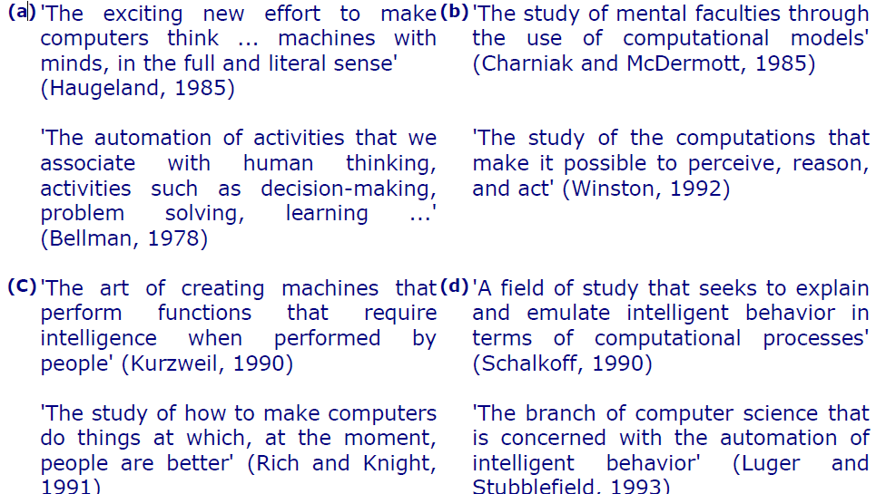
Definitions of AI

Slide 14
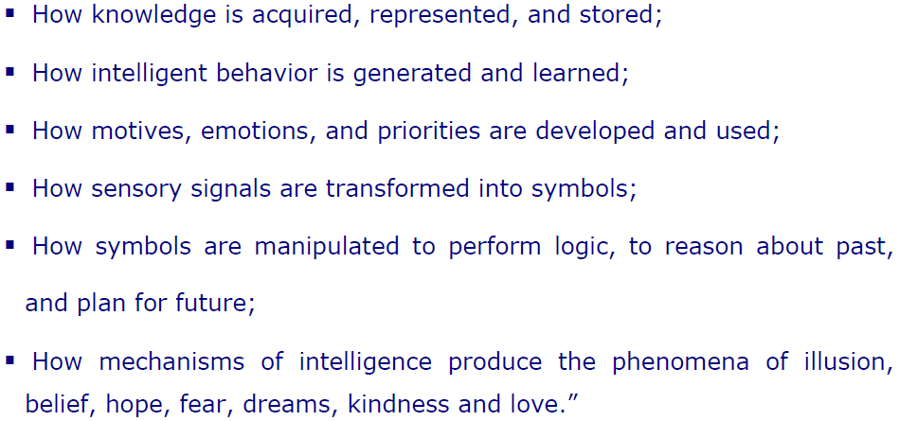
Understanding AI

Slide 15

AI Applications
Transportation:
Autonomous vehicle control:

Slide 16

AI Applications
Transportation:
Pedestrian detection:

Slide 17
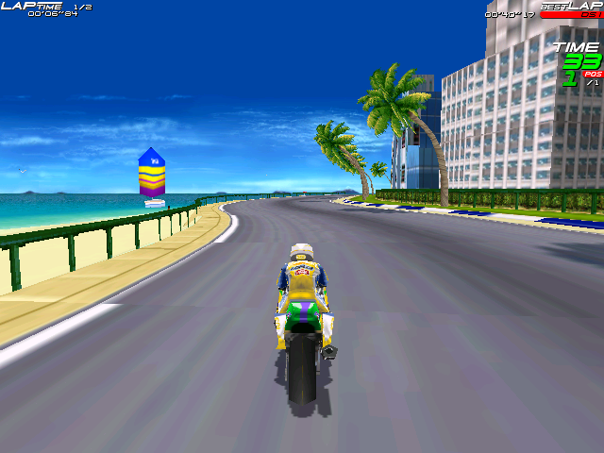
AI Applications
Games:

Slide 18
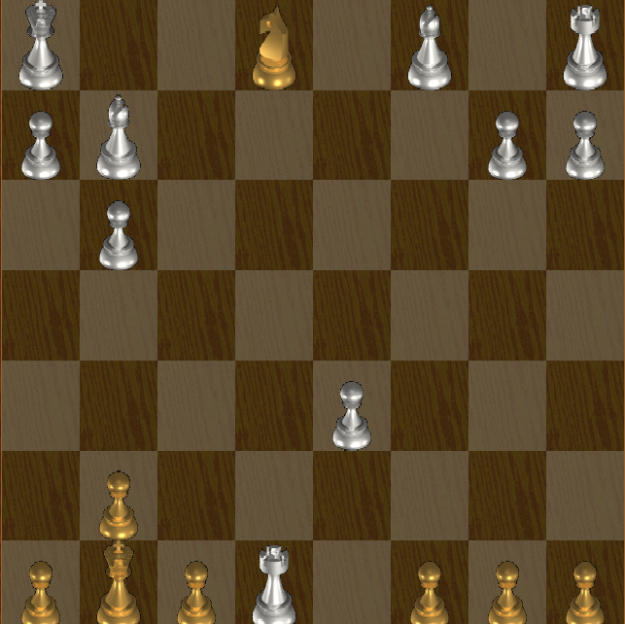
AI Applications
Games:

Slide 19
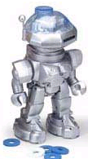

AI Applications
Robotic toys:

Slide 20
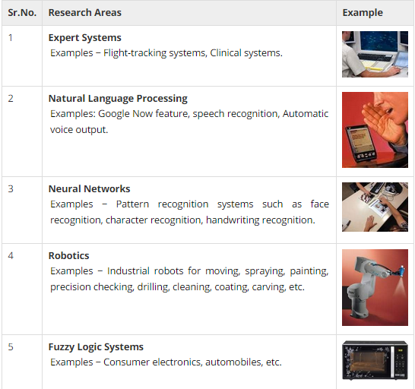
Applications Of AI

Slide 21
Advantages of Artificial Intelligence
More powerful and more useful computers
New and improved interfaces
Solving new problems
Better handling of information
Relieves information overload
Conversion of information into knowledge

Slide 22
Disadvantages of Artificial Intelligence
Increased costs
Difficulty with software development - slow and expensive
Few experienced programmers
Few practical products have reached the market as yet.

Slide 23
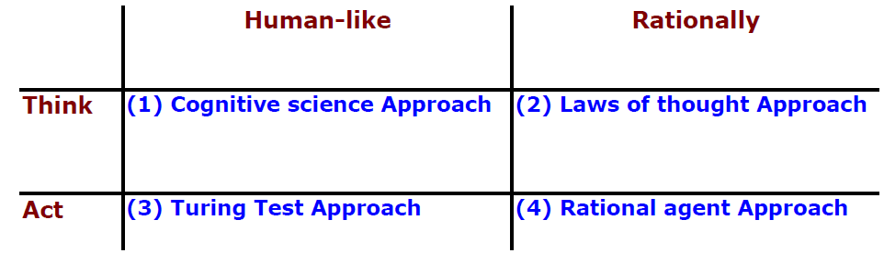
Goals / Approaches Of AI
Definitions of AI leads to four possible approaches for AI:-
Systems that think like humans – Cognitive Science Approach.
Systems that think rationally – Law of Thought Approach.
Systems that act like humans – Turing Test Approach.
Systems that act rationally – Rational Agent Approach.
Most of the AI work falls in Category (2) and (4).

Slide 24
Cognitive Science : Think like a human
Cognitive science aims to develop, explore and evaluate theories of how the mind works through the use of computational models.
The goal is to make machines think like a human.
Goal is not just to produce human-like behavior but to see if machine follows the reasoning process i.e to verify that machine follows the steps which are similar to the steps followed by the human while solving a problem.

Slide 25
Law of Thought : Think Rationally
It is the study of mental faculties through use of computational models.
It is basically the study of computations that make it possible to perceive, reason, act.
Focus is on inference mechanism which are provably correct and provide optimal solution.

Slide 26
Law of Thought : Think Rationally
Inference is the process of deriving a conclusion on what one already knows.
For eg:- “Socrates is a man. All men are mortal. Therefore Socrates is Mortal”.
The goal is to formalize the reasoning process as a set of rules and procedures for inference.
But the issue is not all problems can be solved by just reasoning and inferences.

Slide 27
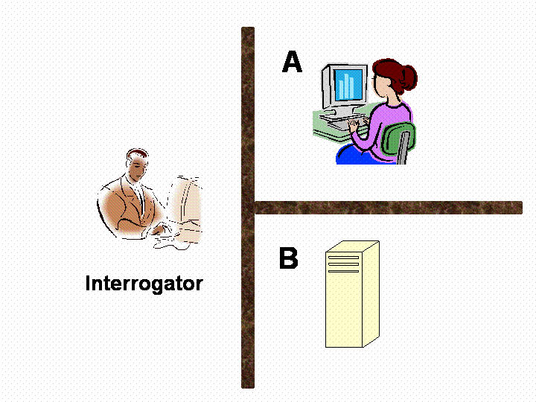
Turing Test: Act Human Like
It is the study of how to make computers do things which at the moment people do better.
Focus here is on action, and not on intelligent behavior.
Goal is to develop systems that are human like.
Turing Test:

Slide 28
Turing Test
3 rooms: a person, a computer, and an interrogator.
The interrogator can communicate with the other 2 by teletype.
The interrogator tries to determine which is the person and which is the machine.
The machine tries to fool the interrogator to believe that it is the human, and the person also tries to convince the interrogator that it is the human.
If the machine succeeds in fooling the interrogator, then conclude that the machine is intelligent.

Slide 29
Rational Agent : Act Rationally
Rational means to do the things rightly.
Focus here is on systems that act sufficiently if not optimally in all situations.
Goal is to develop systems that are rational and sufficient.

Slide 30
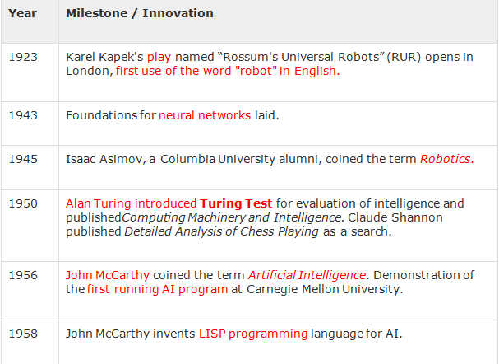
History Of AI

Slide 31
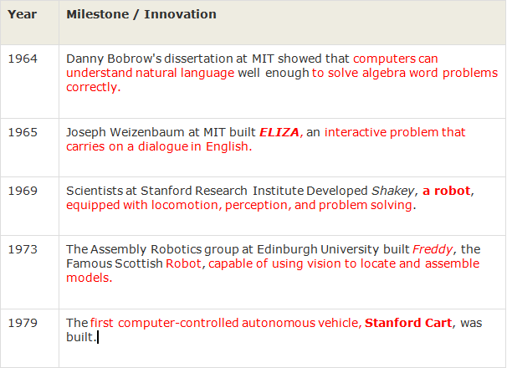
History Of AI

Slide 32
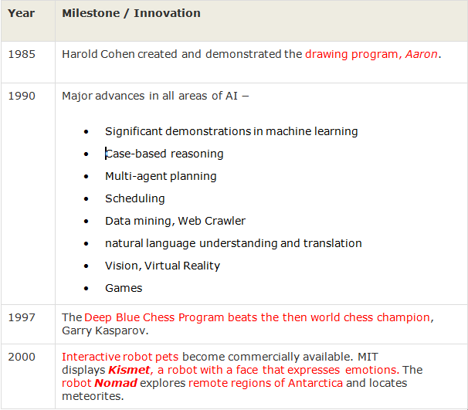
History Of AI

Slide 33
Foundations Of AI
Philosophy Logic, methods of reasoning, mind as physical system, foundations of learning, language, rationality.
Mathematics Formal representation and proof, algorithms, computation, (un)decidability, (in)tractability
Probability/Statistics modeling uncertainty, learning from data
Economics utility, decision theory,.
Neuroscience neurons as information processing units.
Psychology/ how do people behave, perceive, process cognitive
Cognitive Science information, represent knowledge.
Computer building fast computers engineering
Control theory design systems that maximize an objective function over time
Linguistics knowledge representation, grammars

Slide 34
AI Agents
An agent is anything that can perceive its environment through sensors and acts upon that environment through actuators/effectors.
Human agent -> Sensors (Eyes, ears, nose, and other organs)
Actuators (Hands, Legs, vocal tract, etc.)
Robotic Agent -> Sensors (Cameras, infra red finders)
Actuators (Various motors)
Software Agent ->Sensors(Keystrokes, file contents, N/W pkts)
Actuators(Displaying on screen, writing
files, sending network packets, etc.)

Slide 35
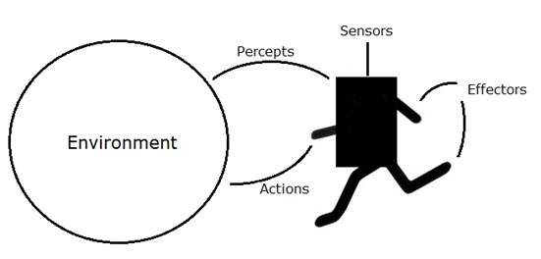
An AI is composed of an agents and its environment.
The agents act in their environment.
The environment may contain other agents.

Slide 36
State Space Search

Slide 37
General Search
Definition 1 – Search is an algorithm that discovers or locates path to the solution.
Definition 2:- Search is an algorithm that takes a problem as input and returns with a solution from the search space.
The search space is the set of all possible solutions.
Solution is a state where all requirements are fulfilled. Such a state is called as Goal State.
A state space [S, A, I, G] is a collection of states, arcs between them and a non-empty set of intial states and goal states.

Slide 38
Control Strategies
Control strategies guides how to reach the goal state or what way has to be followed in order to find a solution.
Types Of Search Control Strategies:-
Forward Search –
The search proceeds from initial state to the goal state.
The methods are called Data Directed.
E.g.:- Searching a city on the map.
2. Backward Search –
The search proceeds backward from goal state to the initial state.
The methods are called Goal Directed.

Slide 39
Control Strategies
3. Systematic Search –
Here no information about domain is available. It can only distinguish between goal and non-goal state.
Used when search space is small.
E.g.:- BFS, DFS are two methods that use this strategy.
4. Heuristic Search –
Many search depend on knowledge of problem domain.
They have some measure of relative merits to guide the search.
The search so guided are called as heuristic search and the methods are called as heuristics.

Slide 40
Parameters For Search Evaluation
Completeness –
The algorithm is said to be complete if it is guaranteed to find a solution.
2. Optimality/ Admissibility –
A search solution is said to be optimal if it gives the best solution.
3. Time Complexity –
Worst case or average case time required to execute the algorithm
4. Space Complexity-
Maximum memory space required to compute the algorithm
Time and space complexity are measured in terms of
b: maximum branching factor of the search tree
d: depth of the optimal solution
m: maximum length of any path in the state space (may be infinite)

Slide 41
Types of Search Methods
Generally search algorithms are classified into two types:-
1. Uniformed Search -
Also called blind, exhaustive or brute-force search.
Uses no information about the problem to guide the search and therefore may not be very efficient.
2. Informed Search -
Also called heuristic or intelligent search.
Uses information about the problem to guide the search, usually guesses the distance to a goal state and therefore efficient.
But the search may not be always possible.

Slide 42
Uninformed Search
They have no information about the number of steps or path costs required to reach from the current state to the goal state.
These methods are used when there is no prior knowledge or has no information about the past.
The only available knowledge is problem definition.
Following are the uniformed search methods/algorithms:-
1. Breadth First Search
2. Uniform Cost Search
3. Depth First Search
4. Depth Limited Search
5. Iterative Deepening Depth First Search
6. Bidirectional Search

Slide 43
Breadth First Search
A Search strategy in which the highest layer of a decision tree is searched completely before proceeding to the next layer is called Breadth-first search (BFS).
In this strategy, no viable solution is omitted and therefore guarantee that optimal solution is found.
This strategy is often not feasible when the search space is large.
Uses Queue(FIFO) data structure for its implementation.

Slide 44
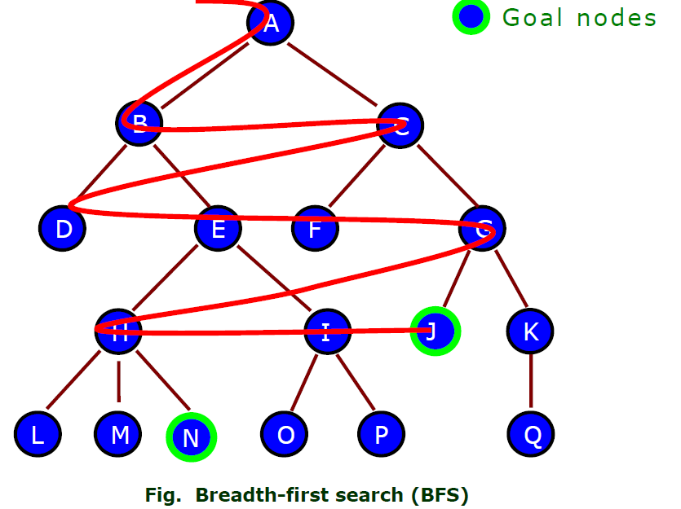
Properties Of BFS
Completeness : Yes. The solution is reached if it exists.
Optimality : Yes. Finds the shortest path
Time Complexity : O(b^d)
Space Complexity : O(b^d)
Every explored node
is kept in memory

Slide 45
Depth First Search Tree
Explores one path to the deepest level and then backtracks until it finds a goal state.
Implemented using stack (LIFO).
This strategy does not guarantee that the optimal solution has been found.
In this strategy, search reaches a satisfactory solution more rapidly than breadth first, an advantage when the search space is large.

Slide 46
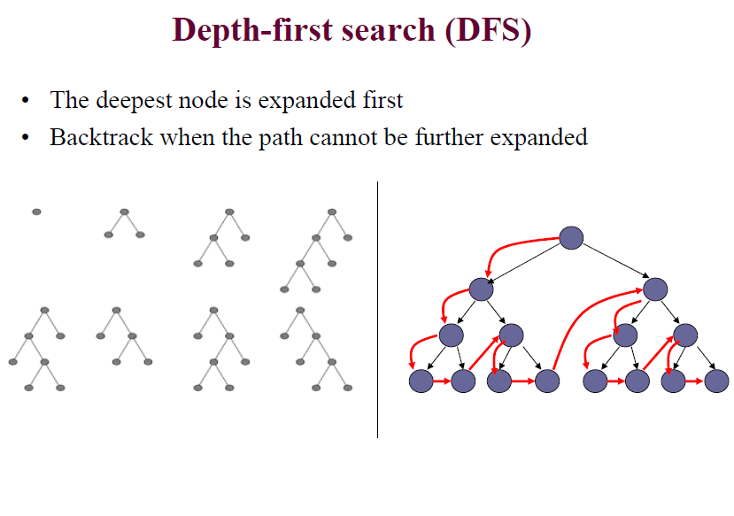
Depth First Search

Slide 47
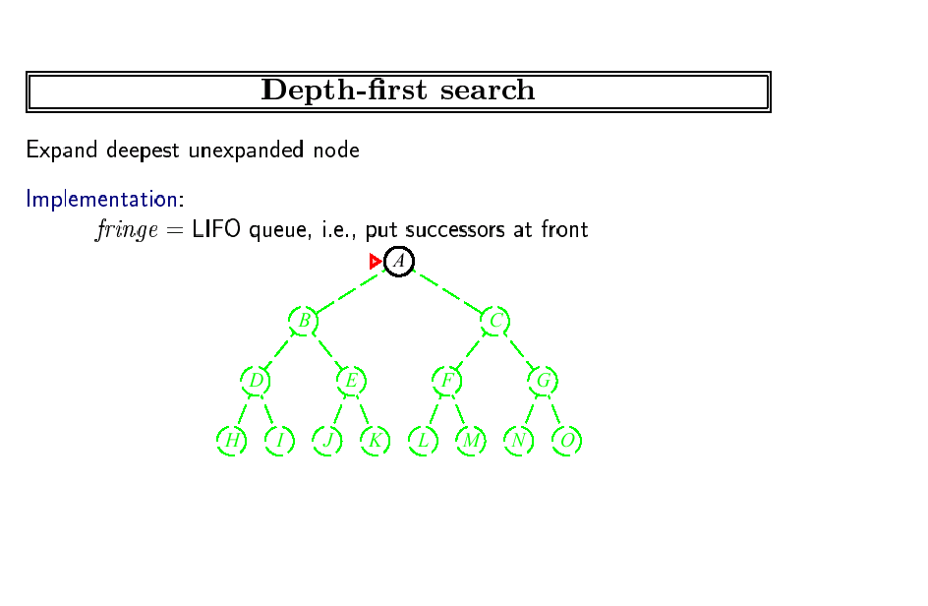
Fringe stack:
A
Expanding A,
gives stack:
B
C
So, B next.

Slide 48
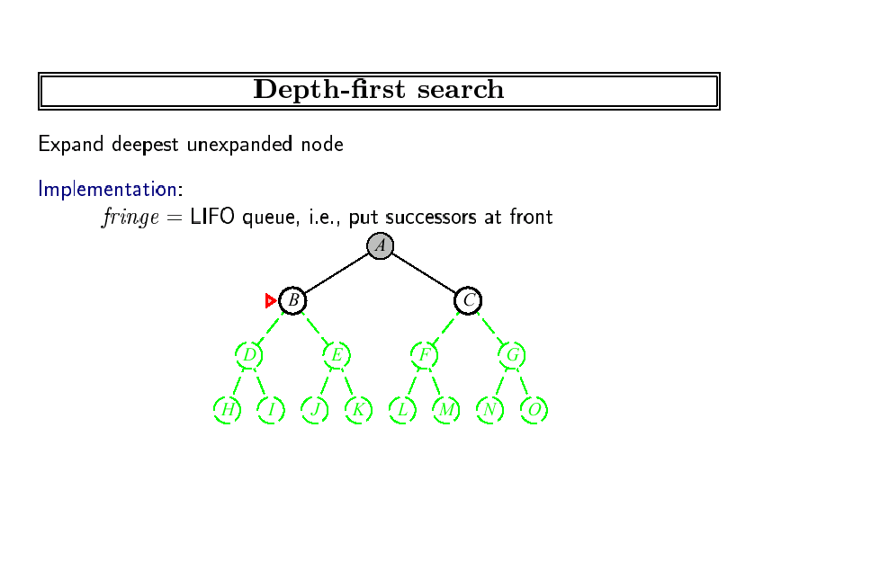
Expanding B, gives stack:
D
E
C
So, D next.

Slide 49
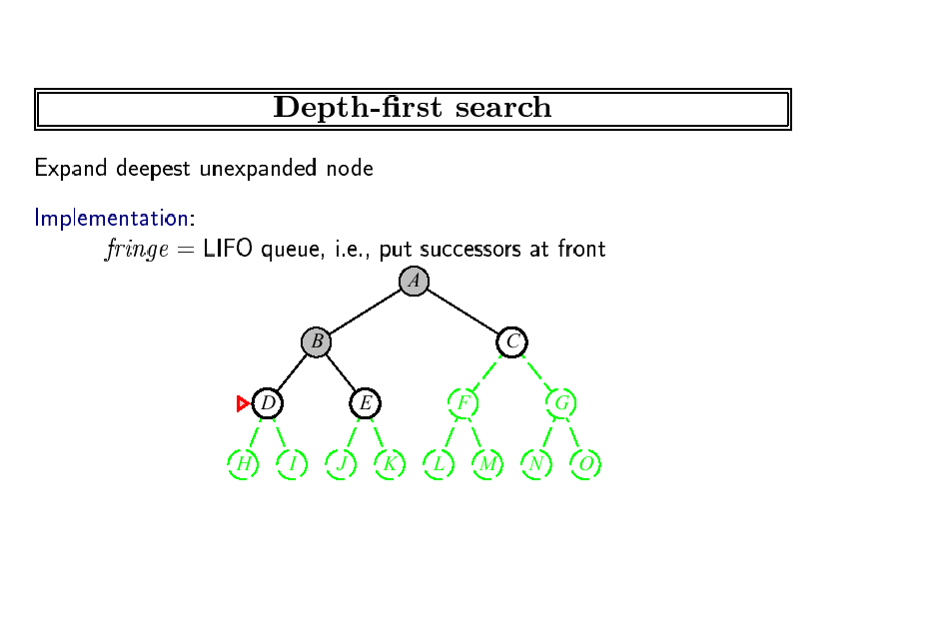
Expanding D, gives stack:
H
I
E
C
So, H next.
etc.

Slide 50
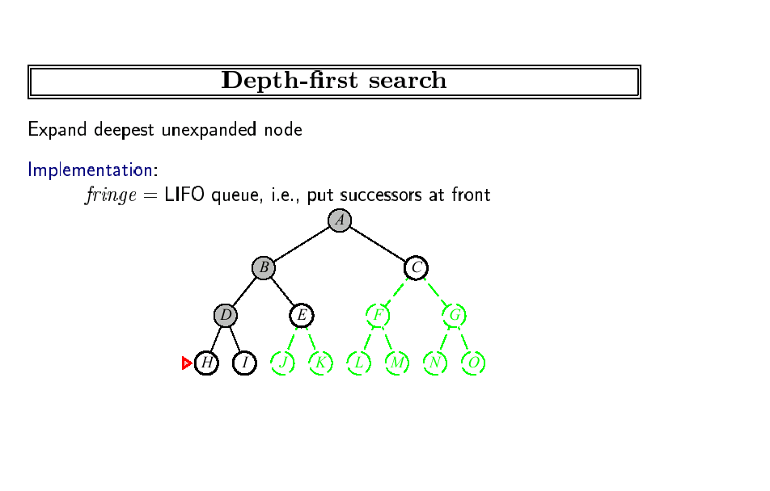
Expanding H, gives stack:
I
E
C
So, I next.
etc.

Slide 51
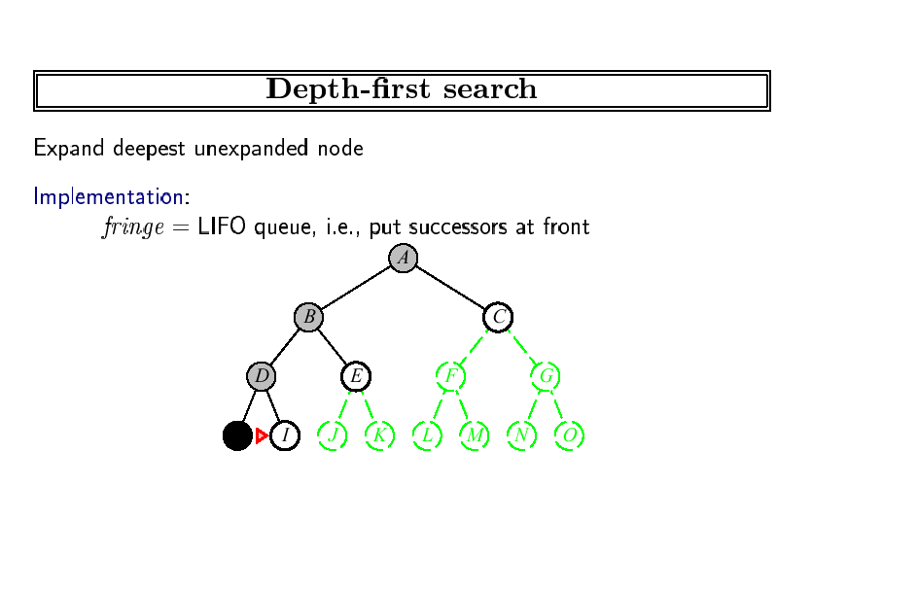
Expanding I, gives stack:
E
C
So, E next.
etc.

Slide 52
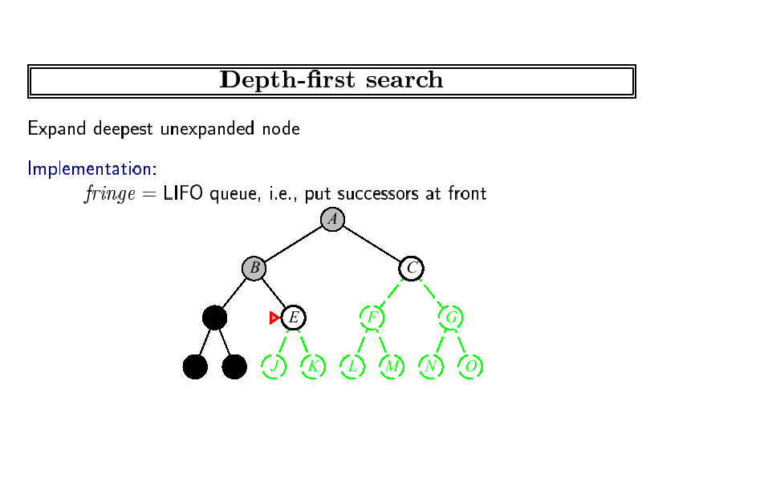
Expanding E, gives stack:
J
K
C
So, J next.

Slide 53
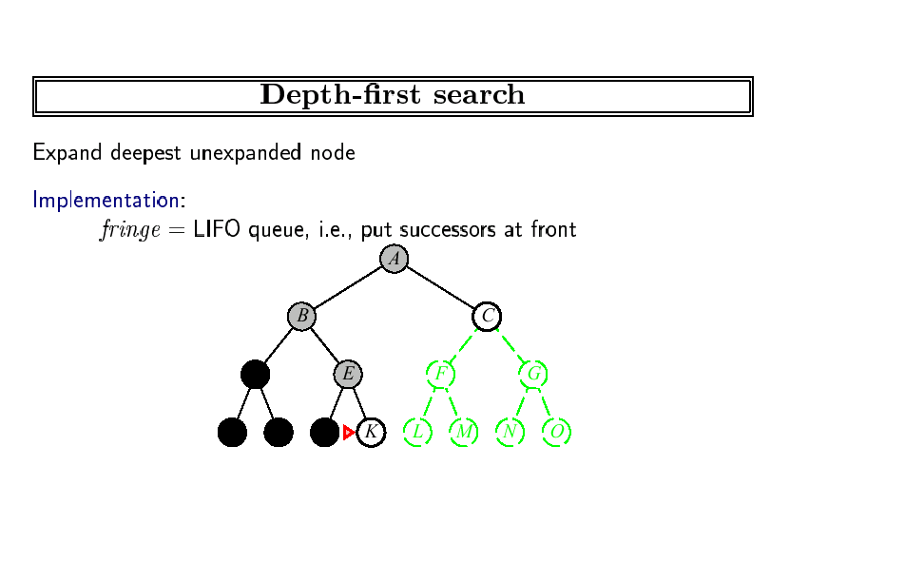
Expanding J, gives stack:
K
C
So, K next.

Slide 54
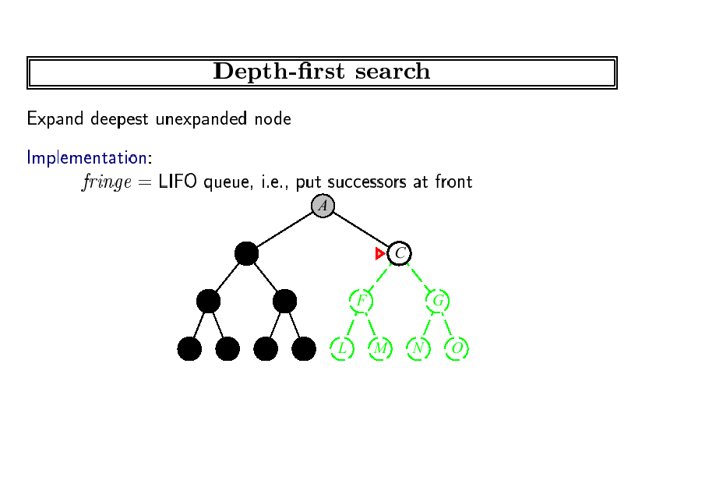
Expanding C, gives stack:
F
G
So, F next.

Slide 55
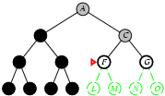
Depth First Search
Expanding F, gives stack:
L
M
G
So, L next.

Slide 56
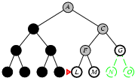
Depth First Search
Expanding L, gives stack:
M
G
So, M next.

Slide 57
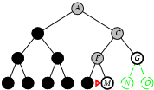
Depth First Search
Expanding m, gives stack:
G
So, G next.

Slide 58
Properties Of DFS
Completeness : No
If the depth of the tree is infinite.
Optimality : No
It stops at the first goal state it finds, no matter if there is another goal state that is shallower than that.
Time Complexity : O(b^d)
Higher than BFS if there is a solution on a level smaller than the maximum depth of the tree.
Space Complexity : O(b*m)
Much lower than BFS
So space complexity of DFS is less but time complexity of DFS is more as compared to BFS.

Slide 59
BFS
Advantages:-
Guaranteed to find a solution if exists(i.e Complete)
2. Guaranteed to provide optimal solution(i.e Optimal)
This is guaranteed by the fact that longer paths are never explored until a shorter ones have already been examined.
Disadvantages:-
Requires more memory space as compared to DFS.

Slide 60
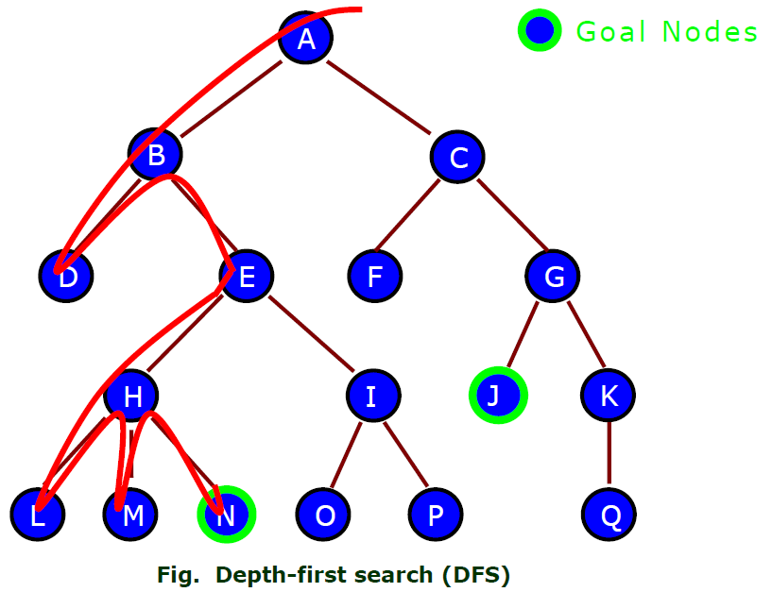
DFS
Advantages:-
Simple to implement.
Needs relatively small
memory space.
Disadvantages:-
Cannot find solution
in all cases( Not Complete).
2. Not guaranteed to provide optimal solution and may take lots of time to give the solution. ( Not optimal)

Slide 61
Backtracking Search
In backtracking, only one successor is generated at a time rather than all successors, each partially expanded node remembers which successor to generate next.
Only O(m) memory is needed rather than O(bm).
Drawback: It can make a wrong choice and get stuck going down a very long (or even infinite) path when a different choice would lead to a solution near the root of the search tree.

Slide 62
Depth limited Search /Depth Bounded DFS
Select some limit in depth to explore the problem using DFS.
How do we select the limit?
This depth limit solves infinite path problems.
DFS can be viewed as a special case of depth-limited search with l=infinity.

Slide 63
Continued…
In order to overcome the infinite length drawback of DFS, a limit on the depth of DFS can be set.
The basic idea is to not allow the expansion of the tree after the given depth.
Not Complete – Since the solution may not be found in all cases. It is complete when depth limit is greater than that of the solution’s depth.
Not Optimal.
Time Complexity : O(b^ l) where l is the depth limit.
Space Complexity : O(b*l) [same as DFS].

Slide 64
Iterative Deepening Search(IDS)
It is an enhanced version of Depth Limited Search.
Sometimes depth limit restricts DLS from finding solution, since solution may exist beyond prescribed depth limit.
IDS is used to address such problems.
If the solution is not found till the given depth limit then the depth limit is incremented by 1. The solution is searched at this level. If the solution is still not found the depth limit is again incremented by 1 and the process goes on.

Slide 65
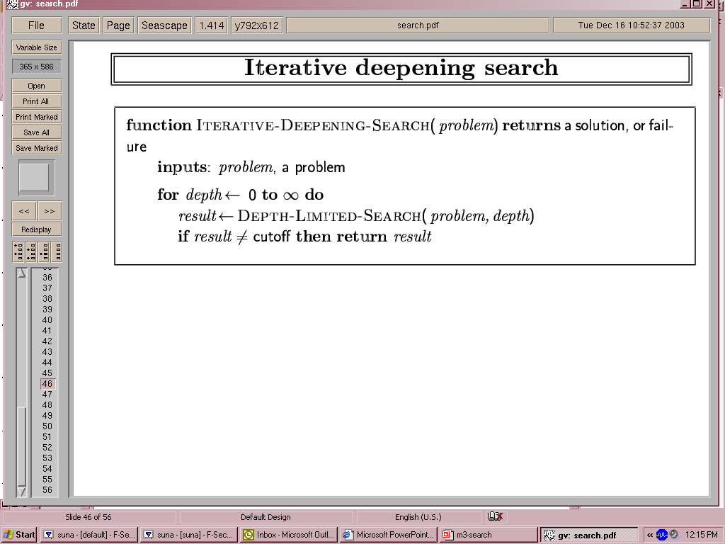
Iterative deepening
Failure : indicate no solution
Cutoff : No solution within the depth limit

Slide 66

Iterative deepening search l =0

Slide 67
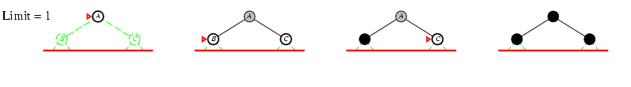
Iterative deepening search l =1

Slide 68
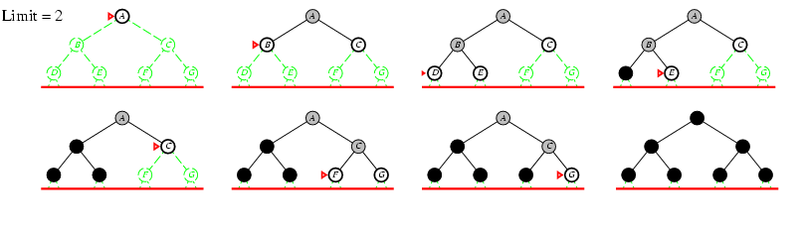
Iterative deepening search l =2

Slide 69
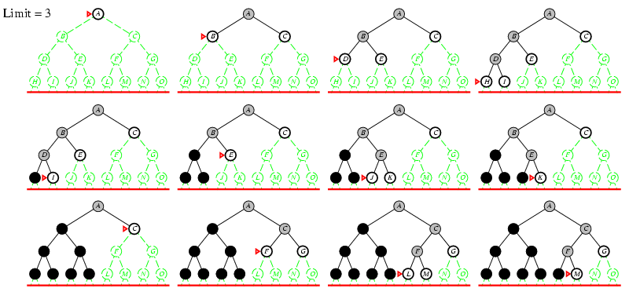
Iterative deepening search l =3

Slide 70
Iterative Deepening Search(IDS)
Complete : Yes
Optimal : Yes
Time Complexity : O(b^d)
Space Complexity : O(b*d)
Limitation :- Regeneration of tree after reaching the depth limit. All previous search results are discarded and we start from scratch.
IDS method is preferred when search space is large and depth factor is known.

Slide 71
Questions
Explain uniformed search and its methods.
Differentiate between breadth first search and depth first search.
Discuss about time and space complexities of the uninformed search techniques.
Explain the following techniques with respect to their performance measures:-
Depth First Search.
Depth Limited Search.
Iterative Deepening Search.

Slide 72
HEURISTIC SEARCH

Slide 73
Informed Search/ Heuristic Search
Was developed to overcome the drawbacks of uninformed search( High Time and Space Complexity)
Informed search uses the information about the domain or knowledge about the problem to move towards the goal state.
These methods do not always find the best solution but they guarantee to find a good solution in a reasonable amount of time. (Not optimal)
These methods are generally used to solve problem that require longer time to find the solution.

Slide 74
Following are the Informed Search Methods:-
Best first search
Greedy methods
A* search
Iterative Deepening A*
Heuristics
AO* Search

Slide 75
Heuristic Function h(n)
It is a function that guides the decision of selecting a path while aiming to reach a goal node.
A heuristic function h(n) provides an estimate of the cost of the path from the given node (n) to reach to the closest goal node.
Informed/Heuristic search algorithms use heuristic function which guides them to reach goal state in less amount of time.

Slide 76
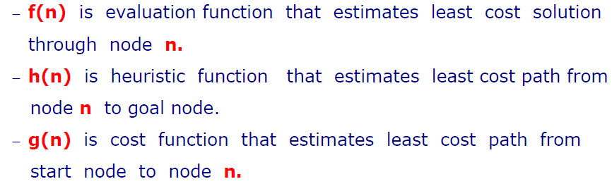
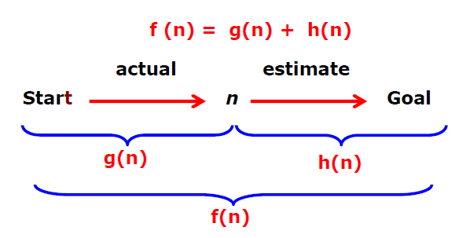
Search Notations

Slide 77
Best First Search
Here nodes are expanded and explored one by one.
An evaluation function f(n) is used to decide which node has to be expanded next.
The node which has lowest value of evaluation is selected for expansion.
Procedure:-
Start with the root node.
The node having lowest value for f(n) is selected. Repeat the process till you get the goal node or till all nodes are explored.

Slide 78
Best-First Search
A
A
A
B
C
D
B
C
D
3
5
1
3
5
E
F
4
6
A
A
B
C
D
B
C
D
5
5
G
H
E
F
G
H
E
F
6
5
4
6
6
5
6
I
J
2
1

Slide 79
Best-First Search
OPEN: Nodes that have been generated, but have not examined.
This is organized as a priority queue.
CLOSED: Nodes that have already been examined.
Whenever a new node is generated, check whether it has been generated before.

Slide 80
Best-First Search
Algorithm
OPEN = {initial state}.
Loop until a goal is found or there are no nodes left in OPEN:
− Pick the best node in OPEN
− Generate its successors
− For each successor:
new → evaluate it, add it to OPEN, record its parent
generated before → change parent, update successors

Slide 81
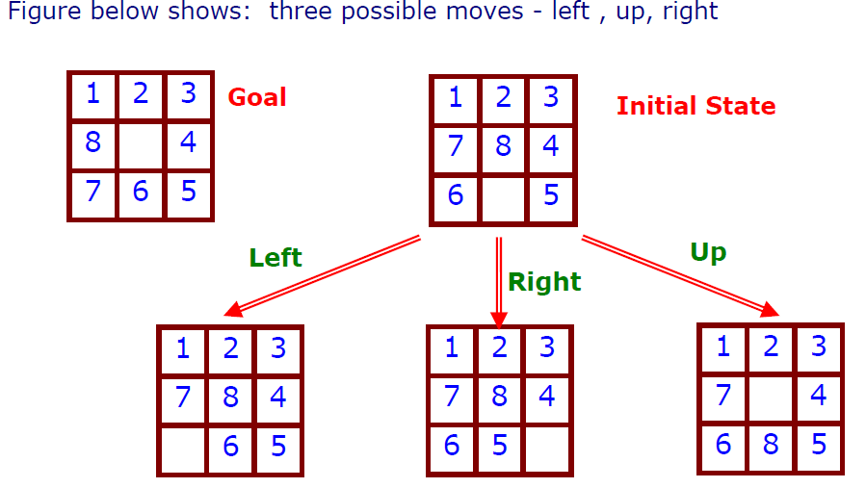
Example of Best First Search
Heuristic here is “ No. of tiles not in correct position”.
Here smaller value of heuristic leads closer towards the goal.

Slide 82
Properties
Not complete – Can lead to an infinite path.
Not optimal –
Heuristics considers best solution at that particular moment (i.e considers current best solution and not future best solution)
Time Complexity – O(b^m) where m ix the maximum depth
Space Complexity – O(b^m)

Slide 83
Hill Climbing Search
This algorithm generally moves up in the direction of increasing value - that is, up-hill.
The basic idea is to always select a state that is better than the current state. i.e it always move to a neighbor which has better score.
It terminates when it reaches a “peak” where no neighbor has a higher value/score.
This algorithm only looks out for immediate neighbors of current state.
It is similar to greedy local search which means it only considers immediate neighbors of the current state.

Slide 84
Continued…
It does not maintain a search tree rather stores only the current node data structure i.e stores the state and its objective function.
Since it keeps no history, it cannot recover from failures of its strategy.
This method works in small settings of specific environment.
This strategy works very well but sometimes it may not be appropriate to be used in real life scenarios due to shape of entire space. Basically heuristic helps in deciding the direction of search.

Slide 85
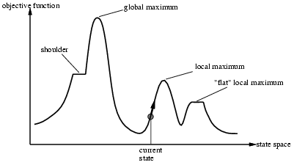
Hill Climbing Procedure
1. Start from initial node.
2. Consider all the neighbors of the current state
3. Choose the neighbor with the best quality and
move to that state
4. Repeat 2 through 4 until all the neighboring states are
of lower quality
5. Return the current state as the solution state.
Notes:
Note:- To find whether current state is better or not evaluation function is used. F(n) is based on heuristic

Slide 86
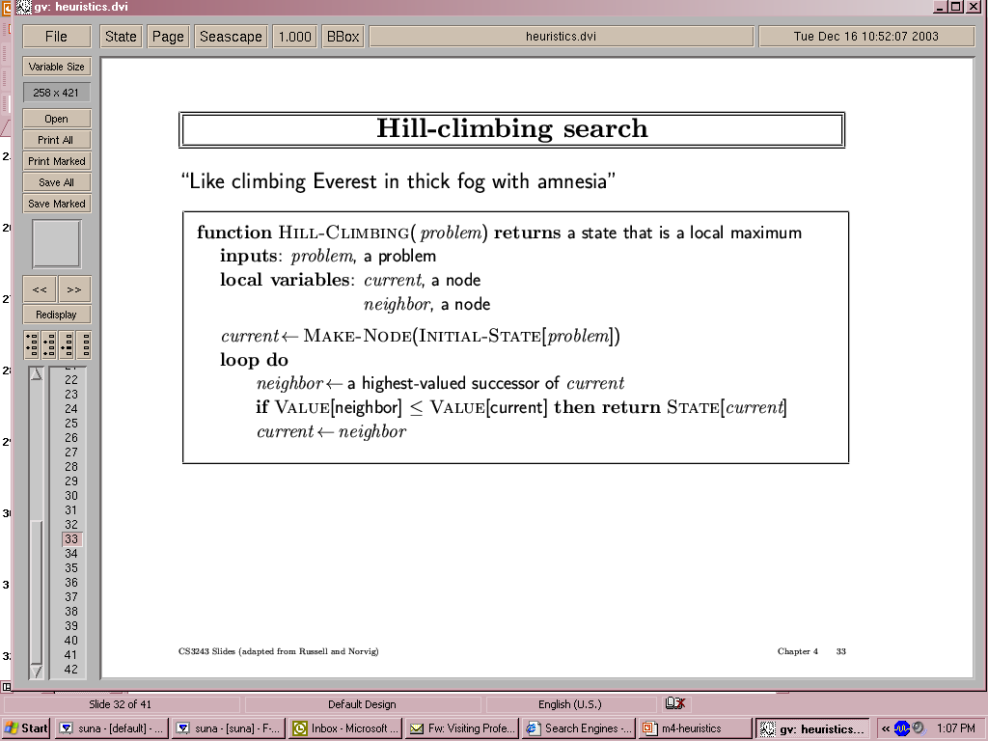

Hill-climbing search
"Like climbing Everest in thick fog with amnesia"

Slide 87
Problems with Hill Climbing
1) Local Maxima – Can’t see higher peak.
This is a state better than the local region or neighboring states but not global maximum.
This occurs since a better solution exists but is not present in vicinity(near) the current state.
Solution – Backtrack to some earlier node and try to move in some other direction.
2) Plateau – It is a flat area of search space where all neighboring states has same value. Algorithm fails to determine best direction to move on.
Solution - Big jump has to be taken in some direction.

Slide 88
Local Beam Search
Beam search is a heuristic search algorithm.
This algorithm expand the most promising (good) nodes from the limited set.
There can be more than one good node selected for expansion, say k nodes.
Algorithm:-
Maintain or select K best states instead of single state.
The search begins with K randomly generated states.
At each iteration, all possible successors of K randomly generated states are identified.
If goal state is found, then halt, else select K best of successors.

Slide 89
Example:- Find best student from the country.
Select k states from country with best results.
Select k cities with best results.
Select k colleges with best results.
4. Select k students who scored maximum marks.
5. Select one student among them with highest marks.
K is the number of best nodes expanded at each level. So K is the width of the beam.
Hill climbing is a special case of local beam search where K= 1.

Slide 90
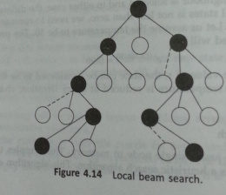
Local Beam Search

Slide 91
Variable Neighborhood Descent
It starts searching with sparse neighborhood function.
When it reaches an optimum, it switches to a denser function.
The hope is that most of the movement would be done in earlier rounds and that time required for searching will also be less.

Slide 92
Tabu Search
Basic idea here is that when there are no better choices instead of terminating as in local search; it tries to continue searching.
This algo does not terminate on reaching a maximum, instead it continues to search until some criterion is met.
Here, at each step worsening moves can also be accepted if no improving move is available.

Slide 93
Tabu Search
Additionally, prohibitions(tabu ) are introduced to discourage the search from coming back to previously visited solution i.e should not visit again/ not consider the solution again(tabu).
When a tabu(forbidden) move has a sufficiently attractive evaluation where it could result in a solution better than any visited so far, then its tabu classification may be overridden. A condition that allows such an override to occur is called an aspiration criterion.

Slide 94
Tabu Search
Tabulist (list of recent history of search)is used for recently visited states and are temporarily excluded from being visited again.
It avoids getting stuck in local maxima.

Slide 95
Basic Ingredients of Tabu Search
A chief way to exploit memory in tabu search is to classify a subset of the moves in a neighborhood as forbidden (or tabu) [1].
A neighborhood is constructed to identify adjacent solutions that can be reached from current solution.
The classification depends on the history of the search, and particularly on the recency or frequency that certain move or solution components, called attributes, have participated in generating past solutions [1].
A tabu list records forbidden moves, which are referred to as tabu moves [5].
Tabu restrictions are subject to an important exception. When a tabu move has a sufficiently attractive evaluation where it would result in a solution better than any visited so far, then its tabu classification may be overridden. A condition that allows such an override to occur is called an aspiration criterion[1].

Slide 96
Flowchart of a Standard Tabu Search Algorithm [7]
Initial solution
(i in S)
Create a candidate
list of solutions
Evaluate solutions
Stopping conditions
satisfied ?
Update Tabu &
Aspiration
Conditions
No
Choose the best
admissible solution
Yes
Final solution

Slide 97
Tabu Search
Advantage :-
It allows to exit from sub-optimal regions by making non-improving solution to be accepted.
Use of tabu list improves efficiency.
Disadvantage:-
1. Cannot find global optimum in some cases.

Slide 98
OPTIMAL SEARCH

Slide 99
A* Search
A* is combination of :
Uniform cost search
g(n): Exact path cost from start state to node n
Greedy search
h(n): Heuristic path cost from node n to a goal state
Heuristic function for A*
f(n) = g(n) + h(n)
Where g(n) = is actual cost
h(n) = estimated cost

Slide 100
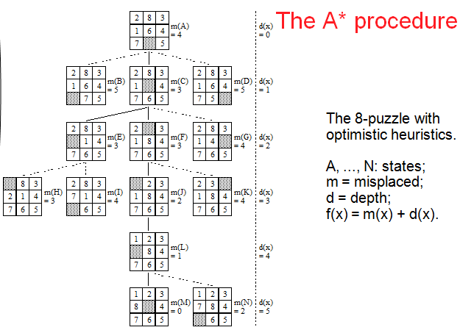

Slide 101
A* Search
Completeness : A* is complete and guarantees solution.
Optimality – A* is optimal if h(n) is admissible heuristic.
An heuristic is admissible if the heuristic value is no longer than the actual cost it takes to reach the goal.
i.e. h(n)<=cost_to_goal
Time complexity depends on heuristic function.
Main issue is about space complexity here since all nodes that are generated are kept in memory.
Generally this method is not used for large scale problem.
Notes:
Admissible heuristic means h(n) never over estimates the cost to reach the goal i.e .e. the cost it estimates to reach the goal is not higher than the lowest possible cost from the current point in the path.

Slide 102
Memory-Bounded Search
Search algorithms that try to conserve memory
Most are modifications of A*
Iterative deepening A* (IDA*)
Recursive Best first search

Slide 103
Iterative Deepening A* (IDA*)
Resolves the problem of A*, where the memory problem is overcome and at the same time optimality is maintained.
Here, threshold for every level of the tree is maintained.
Whenever a node is generated whose cost is more than the threshold of that iteration, the path is discarded. Then backtracking is applied.
Initial cut-off is set equal to heuristic of the root.

Slide 104
Iterative Deepening A* (IDA*) Algo:
Set limit = h(root) //this is f-limit
Prune(Discard) if f(node) > f-limit
Set f- limit equal to the minimum cost of any node that is pruned.
IDA* performs series of depth first searches.
IDA* saves memory space because depth-first keeps only the current path in memory.
IDA* is optimal if admissible heuristics exists.
Limitation :- Excessive Node Generation.

Slide 105
Example
Home 120
F-limit= h(root)=120
Bank 125
School 90
University 100
Garden 140
Flimit =125
Prune 125 > flimit
Prune 140 > flimit
Railway Station 80
Post Office 219
Prune

Slide 106
Recursive Best-First Search
Similar to best-first search, but with lower space requirements
O(bd) instead of O(b^{m})
The basic idea here is to remember the best path or the best alternative(i.e lowest f(n)) and
Backtrack if the best first gets very expensive i.e when the cost exceeds that of previously expanded node.
When backtrack is done, the f-cost of current node(i.e expanded) is replaced with best f-cost of its children.

Slide 107
Example
Home
Bank 125
School 120
Garden 140
Railway Station 145
Post Office 219
Stop expansion & backup

Slide 108
Example
Home
Bank 125
School145
Garden 140
145 is the smallest child value
Police 131
Stop expansion & backup since 131 > 125

Slide 109
Algorithm
If curr_state = goal state
Return Current_state(Success !)
2. Expand (Curr_node) -> Children
3. If empty(children) return failure
4. Do
for each c (child of Curr_node)
f[c]= maximum(g(c) + h(c) , f[curr_node])
best_cost = lowest of f_cost i.e f[c]
if (best_cost > Prev of f-cost found) return failure
Consider alternative f-cost
Goto step1 with(best_cost node, min(f-cost, alternative f-cost)
Notes:
Drawback of IDA* and RBFS is generation of same states again and again.

